Slide 1
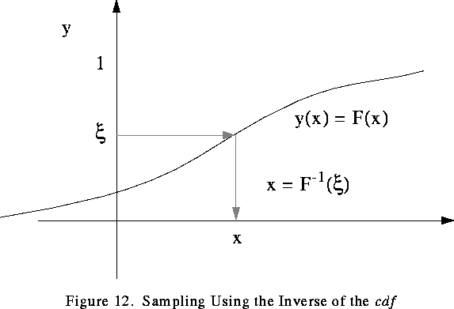
Monte Carlo Simulation
Richard C. Larson
1.203J, 15.073J, IDS.700
November 13, 2017

Slide 2

Notes:
http://www.yeaap.com/wallpaper/Casino-Monte-Carlo-Roulette-Monaco/

Slide 3

Outline
Monte Carlo Sampling from Distributions
Central Limit Theorem and Sampling from Gauss
How-to in more complicated situations
Monte Hall 3-Door Game
Case study – if time
Notes:
http://www.managementscientist.org/

Slide 4
Background
What is Monte Carlo Simulation?
What is it good for? Why do we use it?
Hazards?
How? (Time-Increment vs. Event-paced)

Slide 5
Let’s talk about Monte Carlo sampling: Inverse Method.
Uses CDF, and is Never Fail!

Slide 6
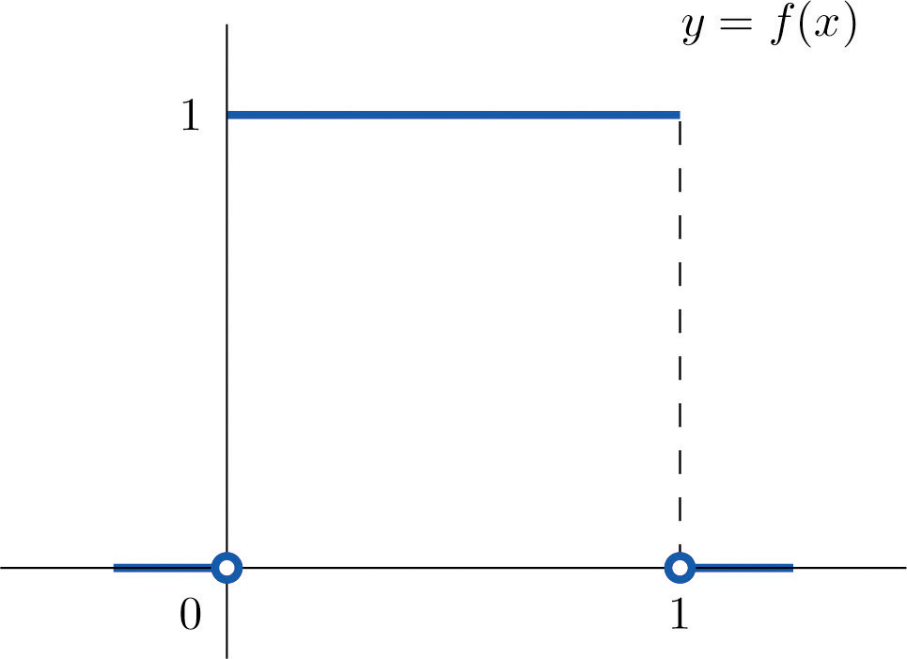
The Power of the Uniform PDF!

Slide 7

How Would You Have the Computer “Roll” Fair Dice?

Slide 8
p_{X}(y)
1/2
1/4
1/4
1
2
3
y
0
F_{X}(y)
1
R=r₁
y
0
1
2
3

Slide 9
p_{X}(y)
1/2
1/4
1/4
1
2
3
y
0
F_{X}(y)
1
R=r₂
y
0
1
2
3

Slide 10
p_{X}(y)
1/2
1/4
1/4
1
2
3
y
0
F_{X}(y)
1
R=r₃
y
0
1
2
3

Slide 11
p_{X}(y)
1/2
1/4
1/4
1
2
3
y
0
F_{X}(y)
1
R=r₄
y
0
1
2
3

Slide 12
Inverse Method Also Works for Continuous Random Variables

Slide 13
f_{X}(y)
1/2
1/4
0
4
y
1
2
3
F_{X}(y)
1
3/4
R=r₁
1/4
0
4
y
1
2
3

Slide 14
f_{X}(y)
1/2
1/4
0
4
y
1
2
3
F_{X}(y)
1
R=r₂
3/4
1/4
0
4
y
1
2
3

Slide 15
f_{X}(y)
1/2
1/4
0
4
y
1
2
3
F_{X}(y)
1
3/4
R=r₃
1/4
0
4
y
1
2
3

Slide 16
f_{X}(y)
1/2
1/4
0
4
y
1
2
3
F_{X}(y)
1
3/4
1/4
R=r₄
0
4
y
1
2
3

Slide 17
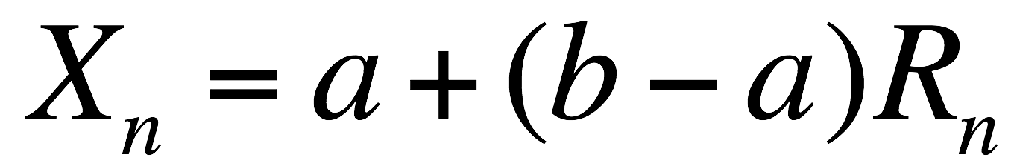
Inversion by formula: Uniform
R.V. X is uniformly distributed between a and b.
R_{n} is the n^{th} random number.
What is the n^{th} sample for the R.V. X?
Notice nice property: Parameters included!

Slide 18
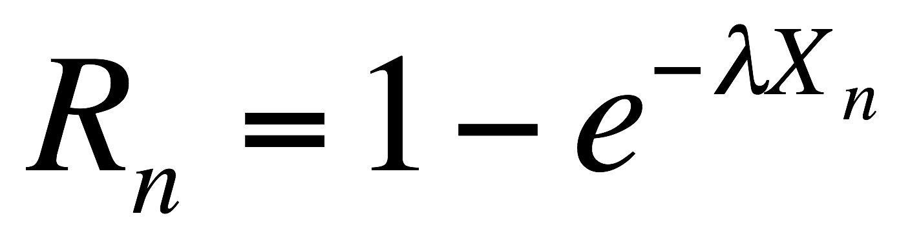
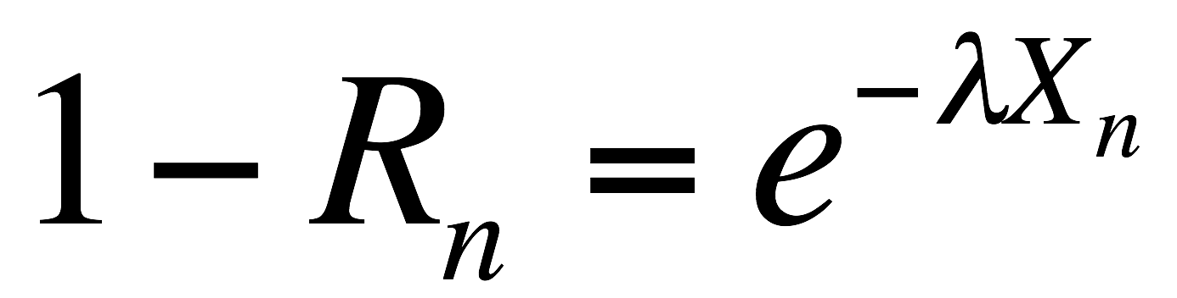
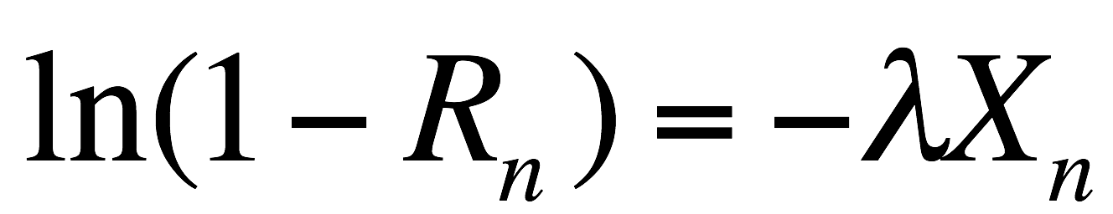
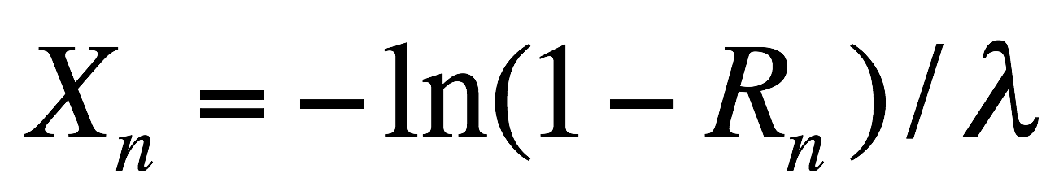
Building Blocks to More Complex Situations
Inversion by formula: Negative Exponential
Let R_{n} = n^{th} random number obtained
Can we play a trick on (1-R_{n})?

Slide 19
Using Building Block
Poisson r.v.?
How do we do that?

Slide 20
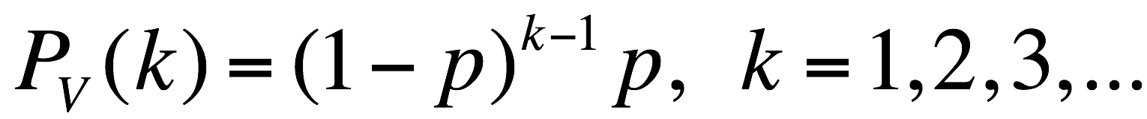
Geometric PMF?
P= Probability of Heads on a Random Coin Toss
V = r.v. equaling the total number of coin flips up to and including the 1st Heads
Inversion method??
Another method….. Flow chart of logic.

Slide 21
Geometric PMF: Random Variable V
Initial Condition: n = 0 = number of coin tosses
n = n + 1
No
Yes
R_{n} < p?
v = n

Slide 22
Geometric PMF: Random Variable V
Initial Condition: n = 0 = number of coin tosses
n = n + 1
No
Yes
R_{n} < p?
v = n

Slide 23
Geometric PMF: Random Variable V
Initial Condition: n = 0 = number of coin tosses
n = n + 1
No
Yes
R_{n} < p?
v = n

Slide 24
2. Rejection Method
PDF having bounded lower and upper bounds on experimental values of r.v. (and bounded PDF values)
Point-polygon method for finding a random point inside an arbitrary polygon.

Slide 25
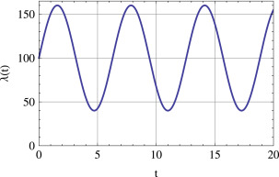
How Would You Simulate a Time-Varying Poisson Process?

Slide 26
Central Limit Theorem Demo

Slide 27
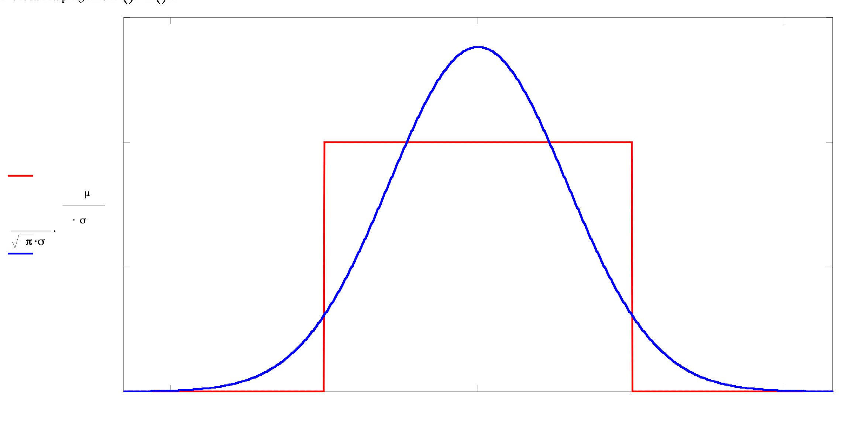
One Uniformly Distributed Random Variable

Slide 28
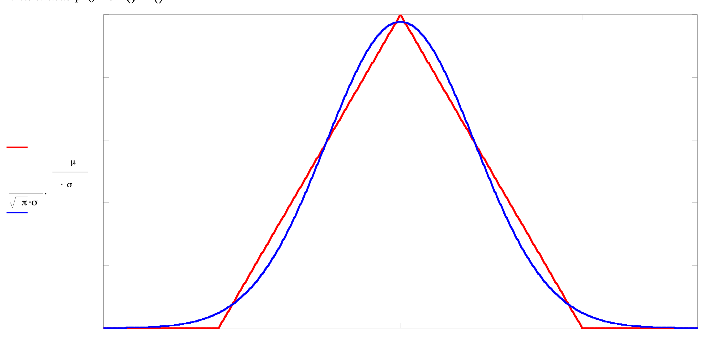
Sum of 2 iid Uniformly Distributed Random Variables

Slide 29
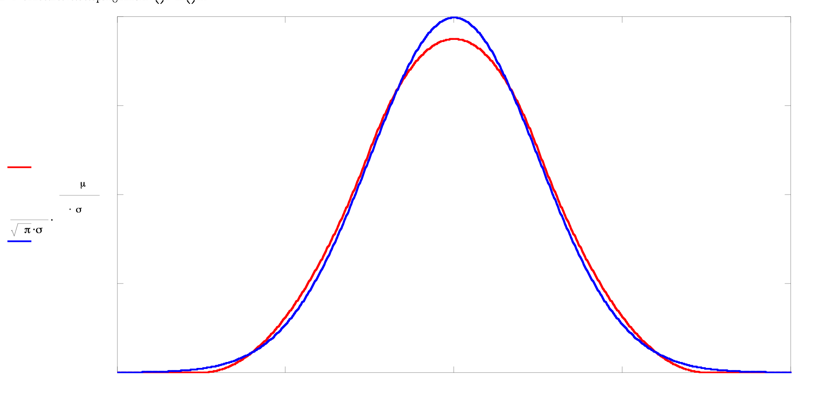
Sum of 3 iid Uniformly Distributed Random Variables

Slide 30
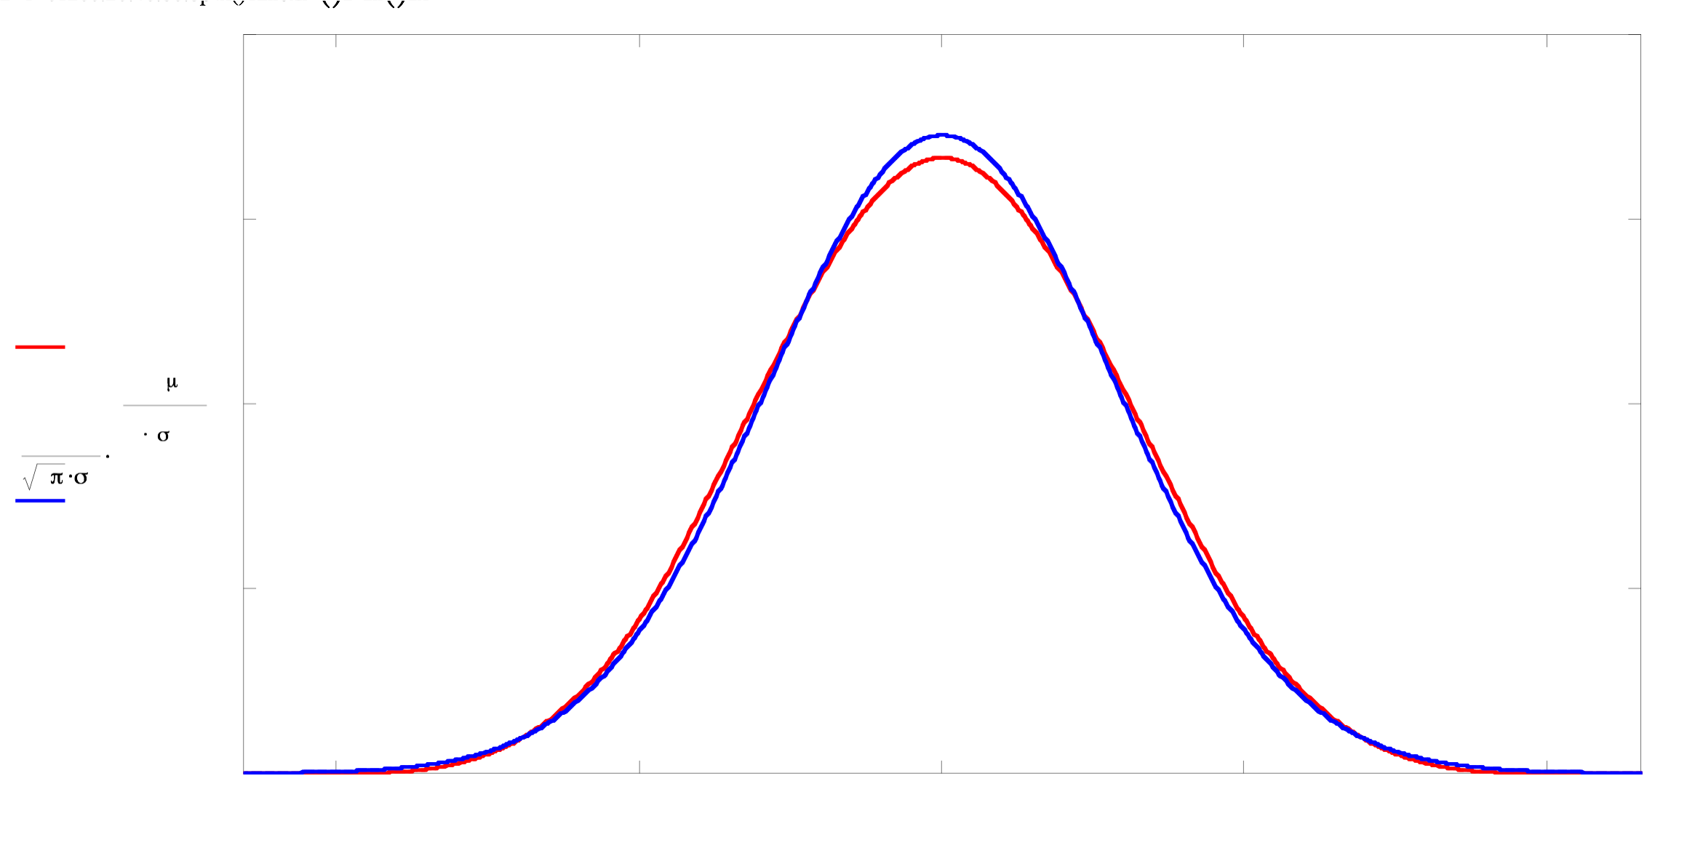
Sum of 4 iid Uniformly Distributed Random Variables

Slide 31
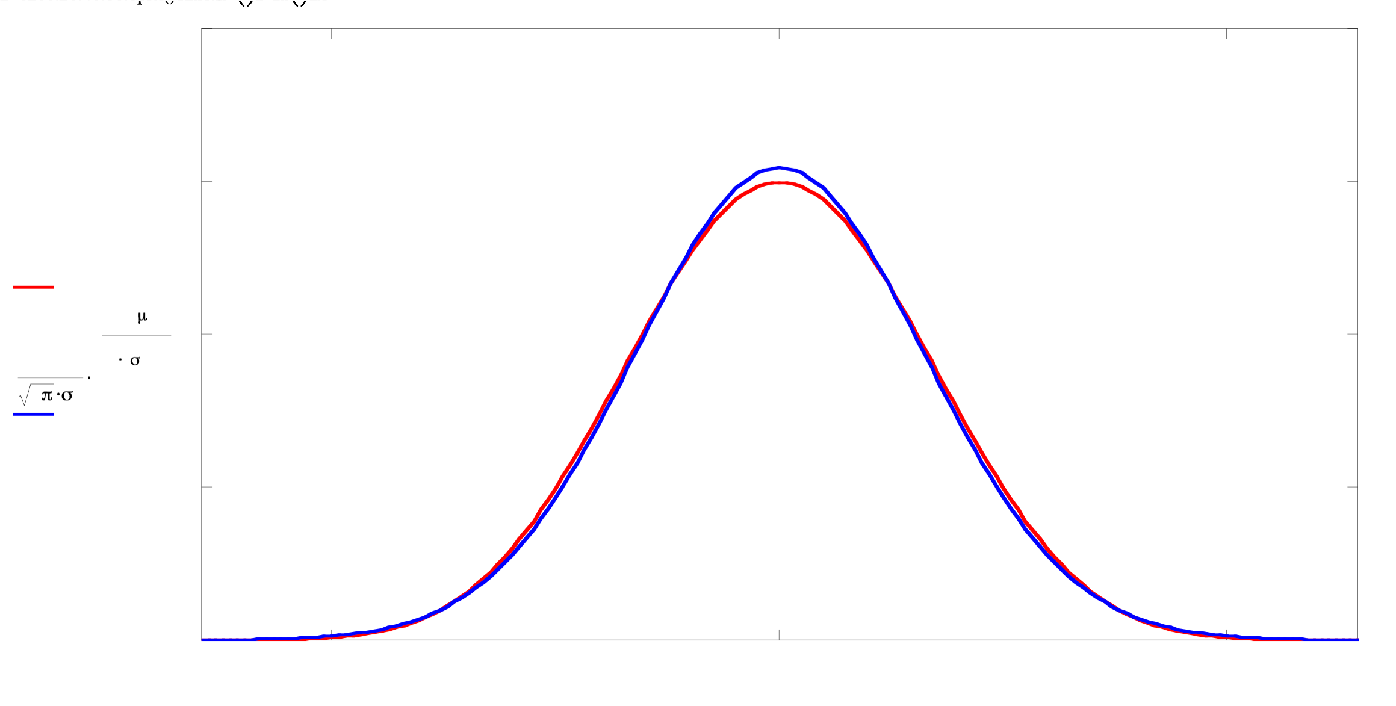
Sum of 5 iid Uniformly Distributed Random Variables

Slide 32
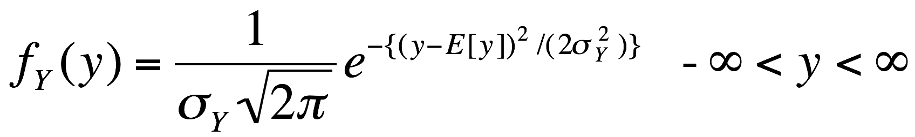
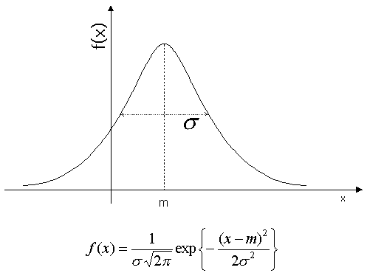
The Gaussian or Normal PDF
http://coding.yonsei.ac.kr/images/f10.gif

Slide 33
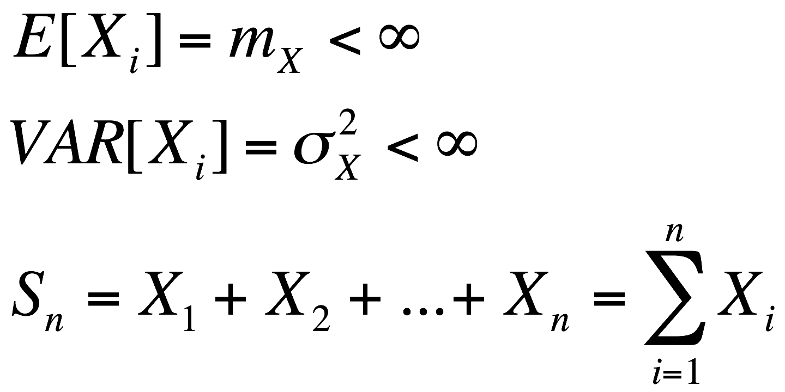
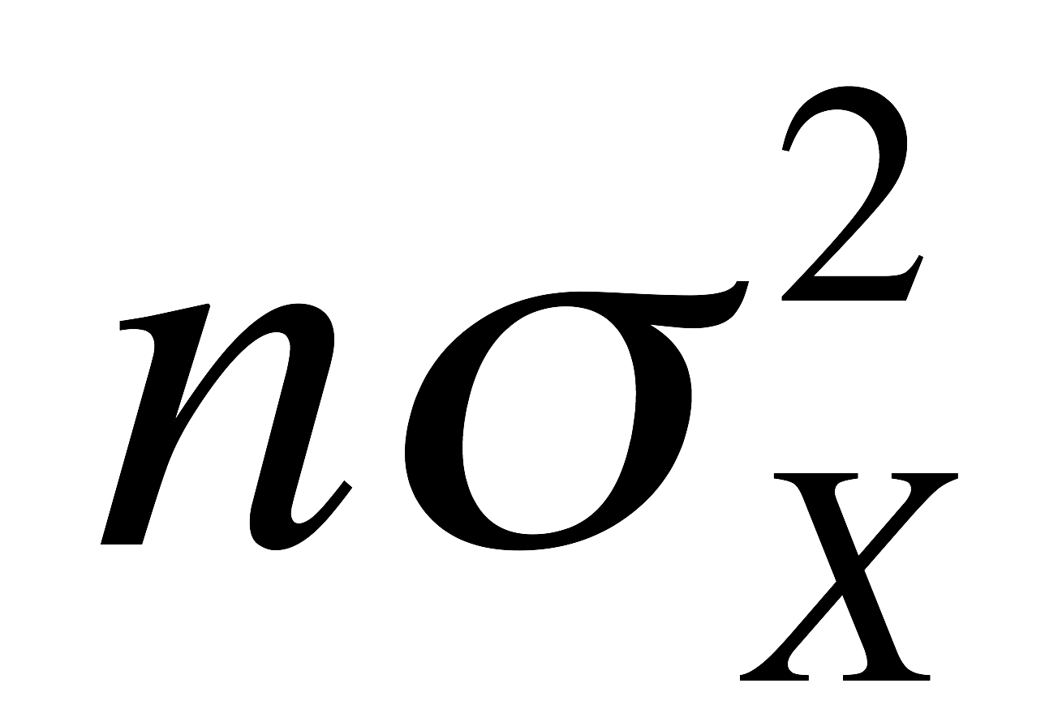
Central Limit Theorem
Consider the sum S_{n} of n iid random variables X_{i}, where
Then, as n ‘’gets large,” S_{n} tends to a Gaussian or Normal distribution with mean equal to nm_{X} and variance equal to .

Slide 34
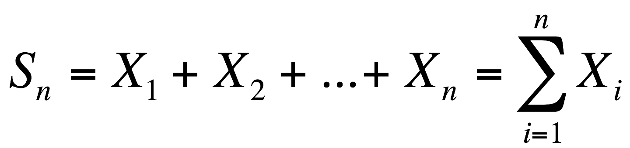
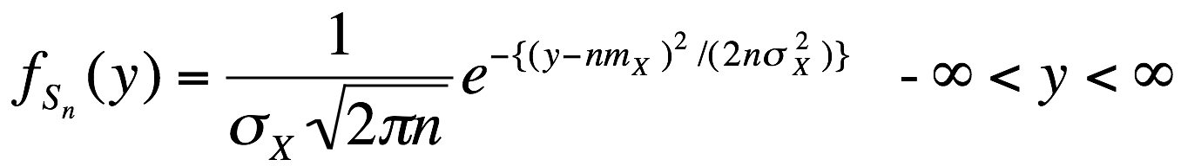
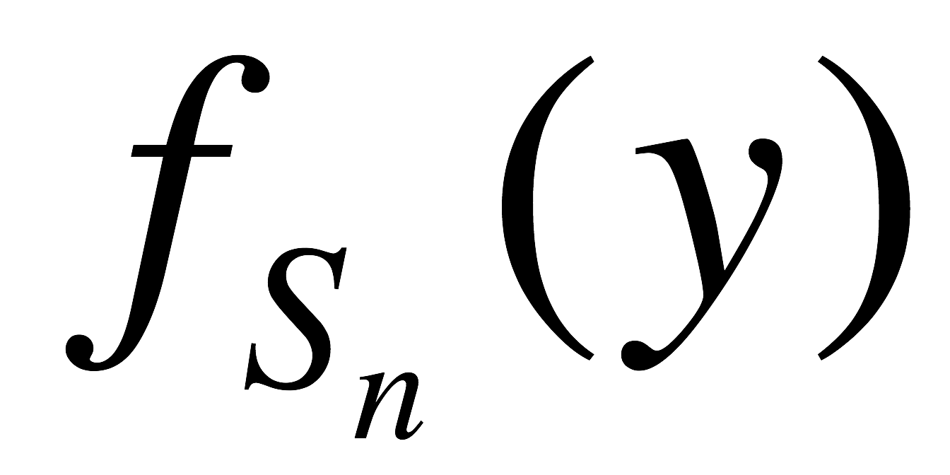
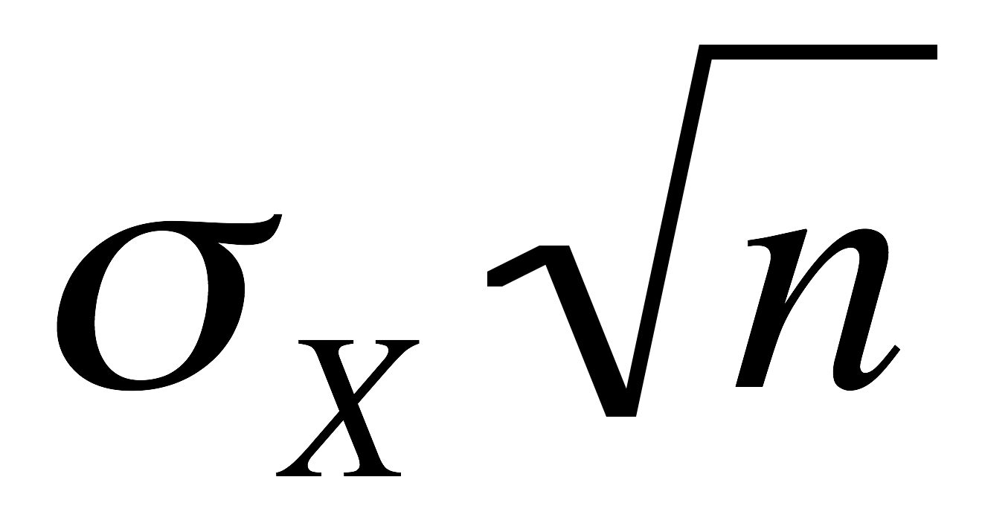
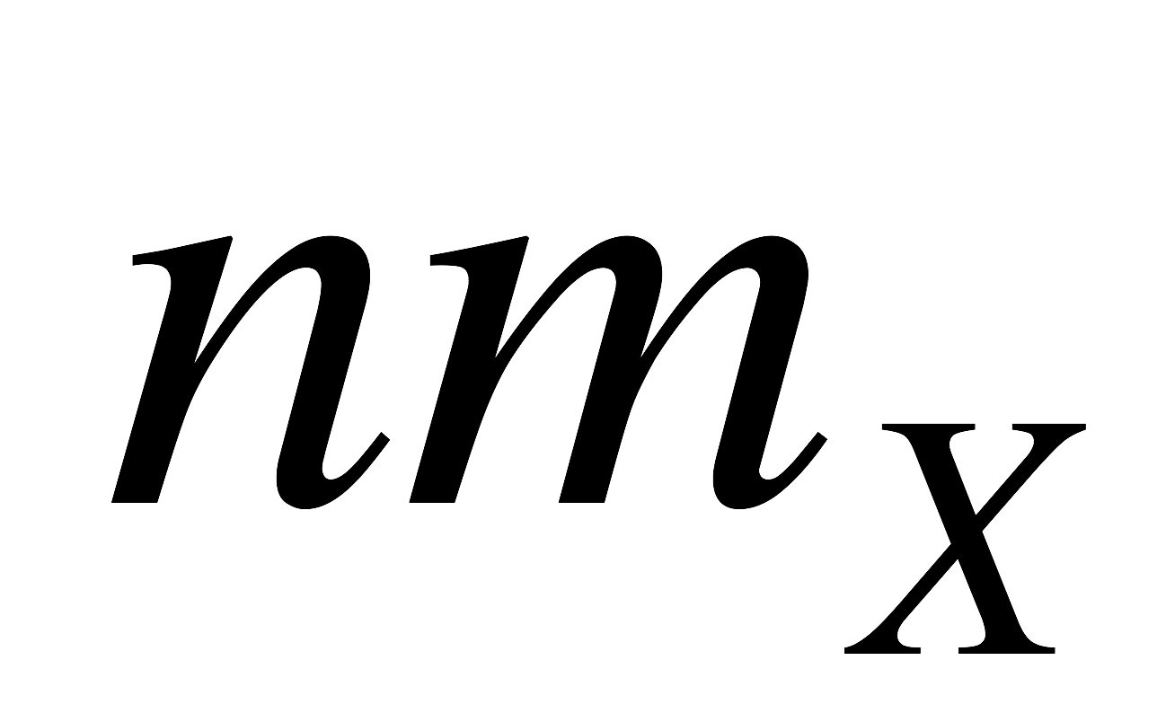
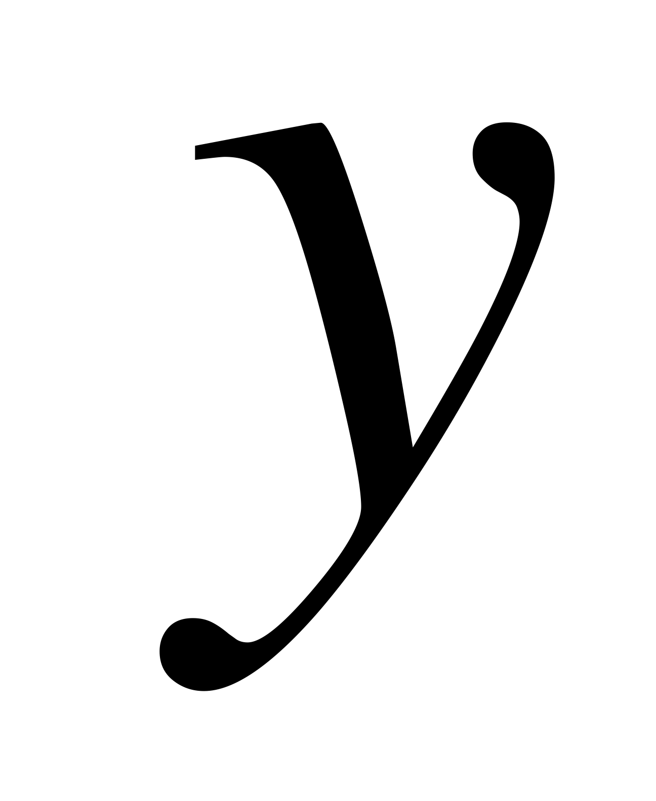
http://coding.yonsei.ac.kr/images/f10.gif

Slide 35
“Sigma”
To achieve Six Sigma, a process must not produce more than 3.4 defects per million opportunities.
About 68% of values drawn from a standard normal distribution are within 1 standard deviation away from the mean; about 95% of the values are within two standard deviations and about 99.7% lie within 3 standard deviations. This is known as the "68-95-99.7 rule" or the "empirical rule".

Slide 36
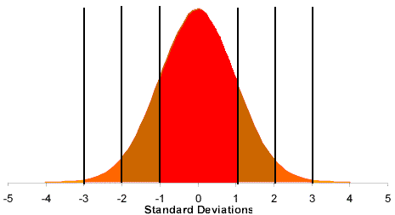
http://www.micquality.com/six_sigma_glossary/continuous_distributions.htm#11

Slide 37
Obtaining Monte Carlo Simulation Samples of the Gaussian R.V.
Why is it difficult?
In Monte Carlo simulations, one often uses the Central Limit Theorem (CLT) to approximate the Gaussian.
Example: Sum and normalize 12 uniforms over [0,1]. Good idea?

Slide 38
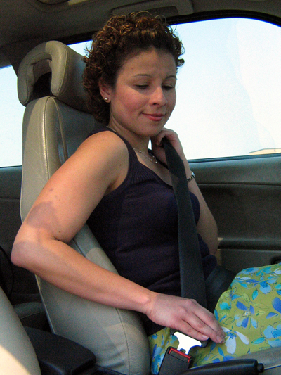
Time to
Buckle your
Seatbelts!
Don’t worry!
This is
For Your Eyes Only!
You are not
responsible for
this math!@
http://www.census.gov/pubinfo/www/multimedia/img/seatbelt-lo.jpg

Slide 39
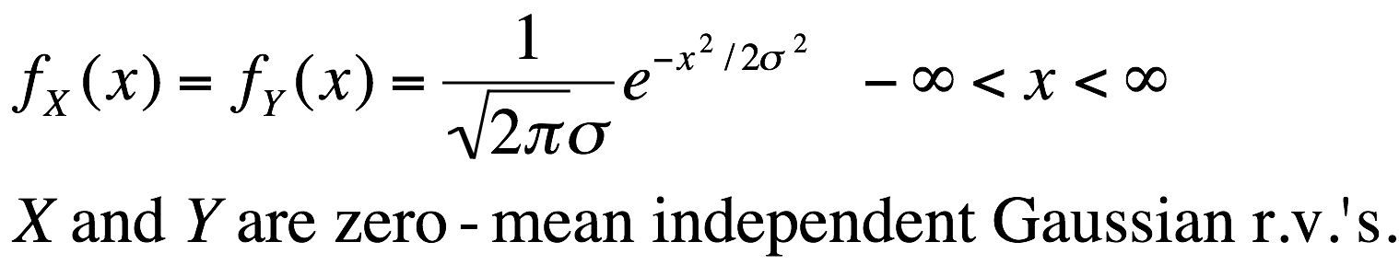
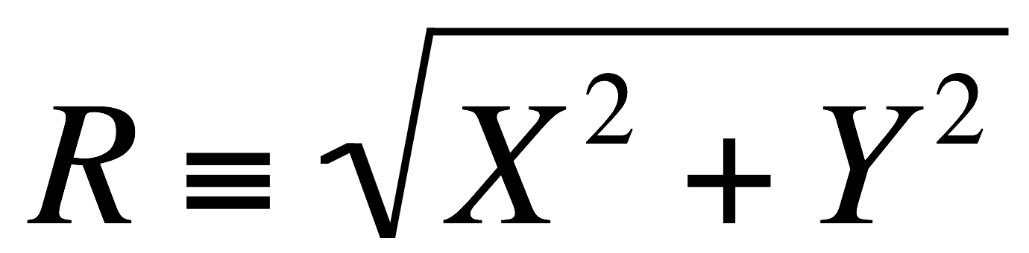
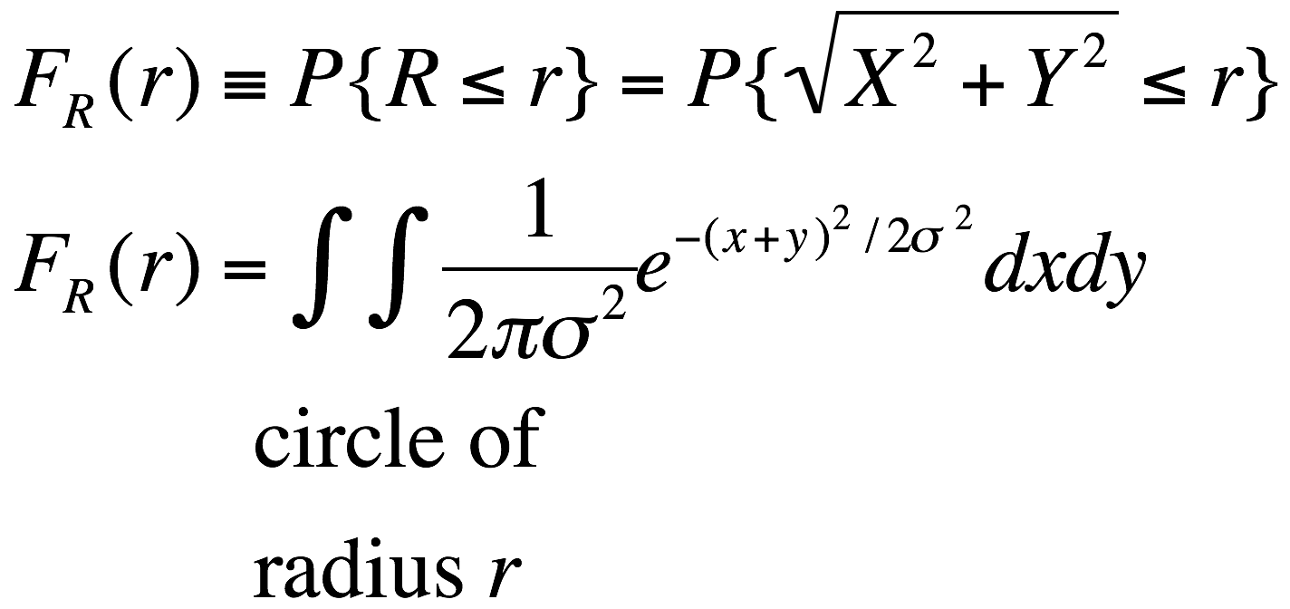
3: The “Relationships Method”

Slide 40
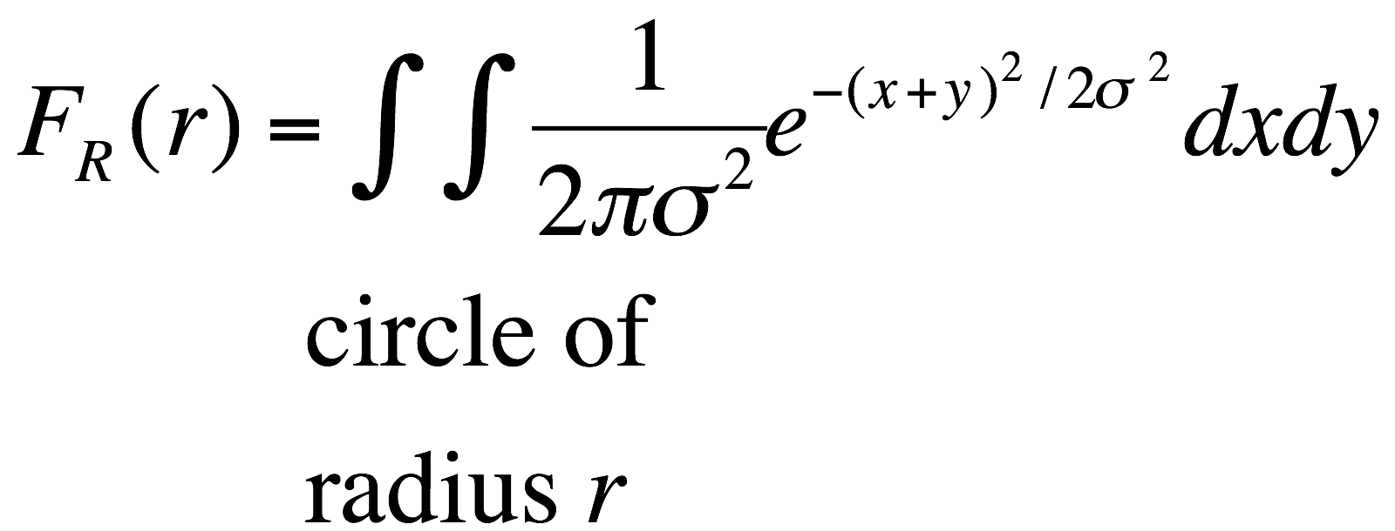
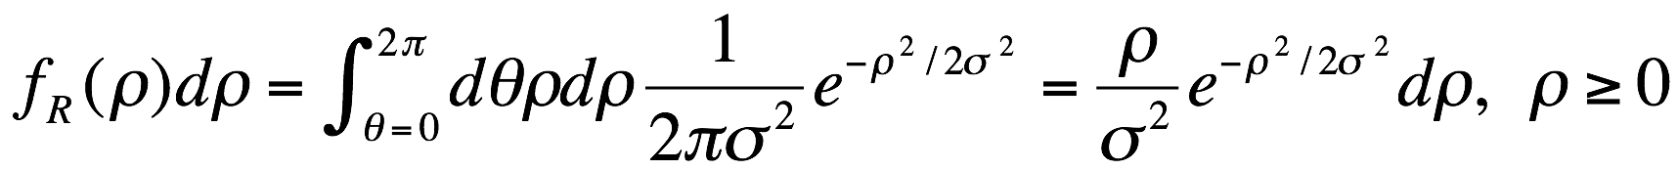
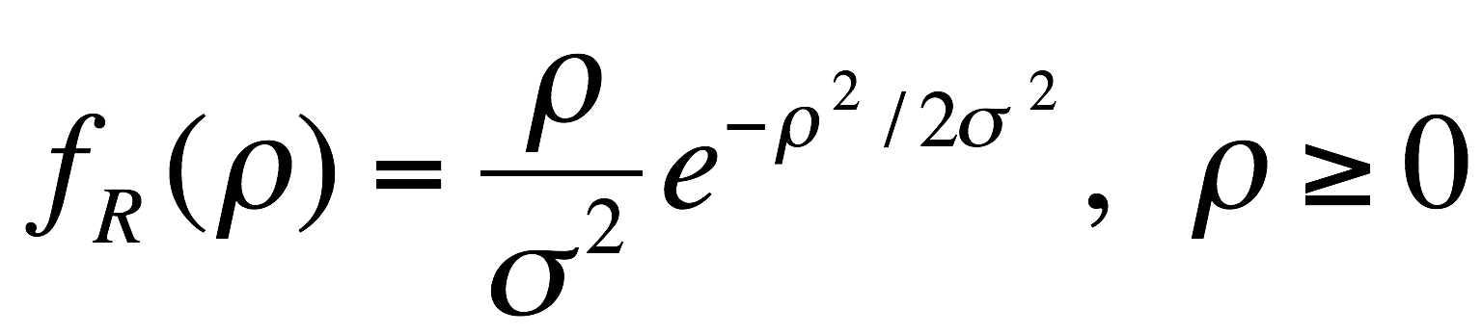
A Rayleigh pdf
With parameter 1/σ

Slide 41
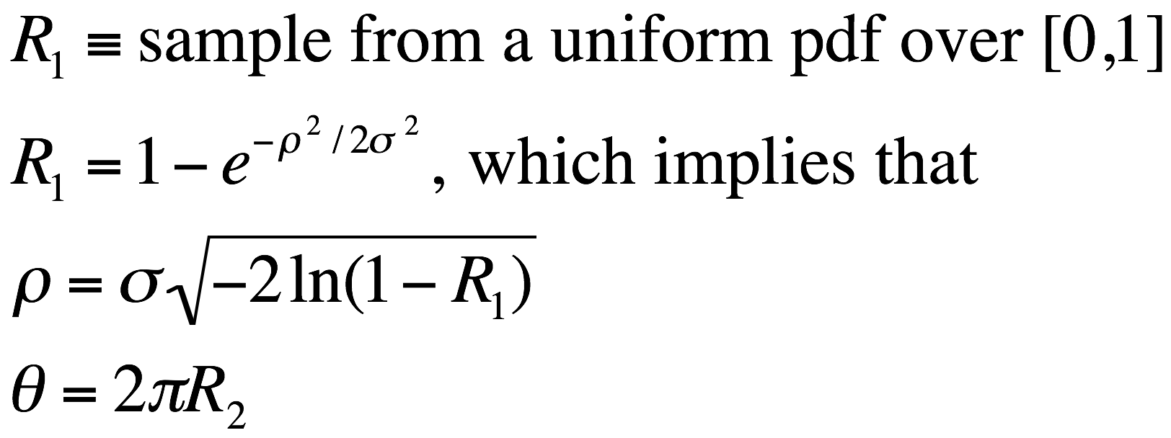
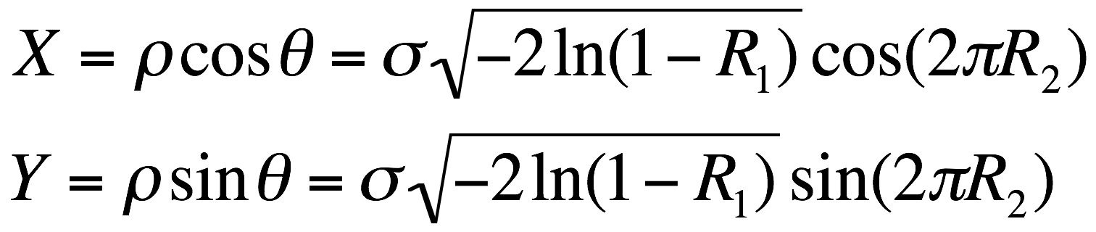
Here we have 2 exact samples from the Gaussian pdf, with no approximation from the CLT!

Slide 42

Monte Hall 3-Door Problem

Slide 43
Simulating Monte Hall
http://blossoms.mit.edu/legacy/monty-hall/index.htm

